Slide 1

Department of computer science and engineering
cmr technical campus
2020-2024
A minor project on
Hospital management system using chatbot
Batch-03
Under the guidance of: -by
s.AParna v.bhavana-207r1a05p5
(Assistant professor) j.pranay - 207r1a05l4
d.Akshay -207r1a05k6

Slide 2
CONTENTS
ABSTRACT
EXISTING SYSTEM
DISADVANTAGES OF EXISTING SYSTEM
PROPOSED SYSTEM
ADVANTAGES OF PROPOSED SYSTEM
HARDWARE AND SOFTWARE REQUIREMENTS
NOVELTY OF THE PROJECT
ARCHITECTURE
MODULES
UML DIAGRAMS
SAMPLE CODE
RESULTS
CONCLUSION
FUTURE SCOPE
REFERENCES
GITHUB LINK

Slide 3
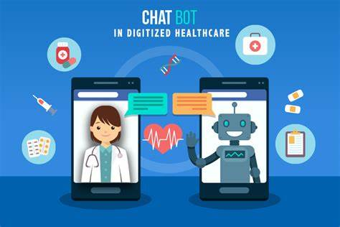
ABSTRACT
We are designing hospital systems where chatbot will accept symptoms from patient and then suggest doctor availability date and time for that symptoms.
These bots connect with potential patients visiting the site, helping them discover specialists, booking their appointments, and getting them access to the correct treatment.
This healthcare chatbot system will help hospitals to provide healthcare support online 24 x 7, it answers deep as well as general questions. By asking the questions in series it helps patients by guiding what exactly patient is looking for.

Slide 4
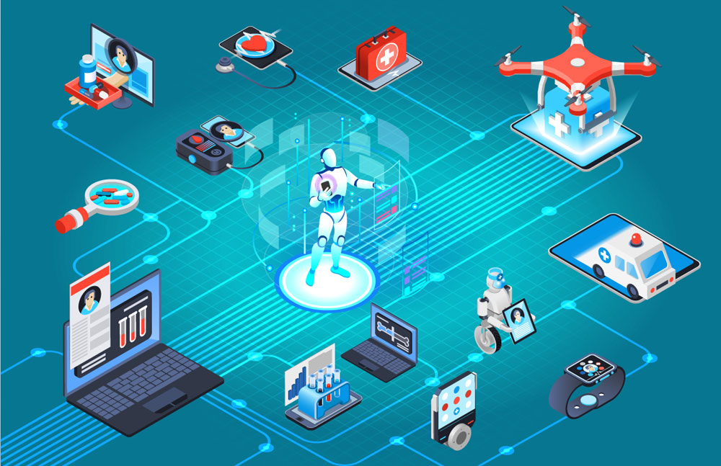
EXISTING SYSTEM
Currently, several hospitals have adopted chatbots for their management systems to enhance efficiency, support, engagement with patients, and healthcare professionals in different ways.
Patient appointment scheduling: Hospitals are using chatbots to simplify the appointment scheduling process for patients. Patients can easily schedule appointments, check availability, and receive reminders before their scheduled visit.
Data collection and analysis: Hospitals has database to collect and analyze data from patients. This information includes personal information, medical history, prescription information, and test results..

Slide 5

DISADVANATAGES OF EXISTING SYSTEM
Lack of Personalization: Chatbots cannot provide personalized recommendations or suggestions for patients as they do not have access to the patient's medical history or records.
Security Concerns: Chatbots may pose a security risk if they are not programmed with adequate security measures. They may inadvertently reveal private patient information to unauthorized personnel, which can lead to serious consequences.
Limited Interaction: Chatbots can only communicate via text or voice chat which does not allow for the display of visual images, videos, or other rich media that may be required to convey certain information.

Slide 6
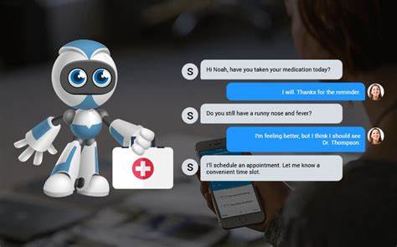
PROPOSED SYSTEM
This is an AI-based tool developed to manage hospital operations using a chatbot interface. This system aims to make hospital management more efficient, improve patient satisfaction and reduce human errors.
We are using the latest technology Django for faster retrieval of answers for the queries by the chatbot.For the website creation we are using html,css and javascript.
Chat Support: Chatbots resolve the query of user regarding any health issues,appointments.etc.
Report Retrieval: Patients can access their medical reports and test results through the chatbot interface. The chatbot will provide a secure link to access the report.

Slide 7


ADVANTAGES OF PROPOSED SYSTEM
Improved Efficiency: The chatbot interface will streamline hospital processes by automating tasks, such as appointment scheduling and inventory management. This will reduce wait times for patients and allow staff to focus on providing better care.
Improved Patient Satisfaction: The chatbot interface will provide patients with quick and convenient access to hospital services. This will improve patient satisfaction by reducing wait times and improving communication.
Reduced Human Errors: The chatbot interface will reduce the likelihood of human errors by automating repetitive tasks, such as inventory monitoring and appointment scheduling.

Slide 8

SYSTEM CONFIGURATION
HARDWARE REQUIREMENTS:
System : i3 or above
Ram : 4G
Hard Disk : 40GB
SOFTWARE REQUIREMENTS:
Operating System : Windows 8 or above
Coding Language : Python
Framework : Django
Database : MySql

Slide 9
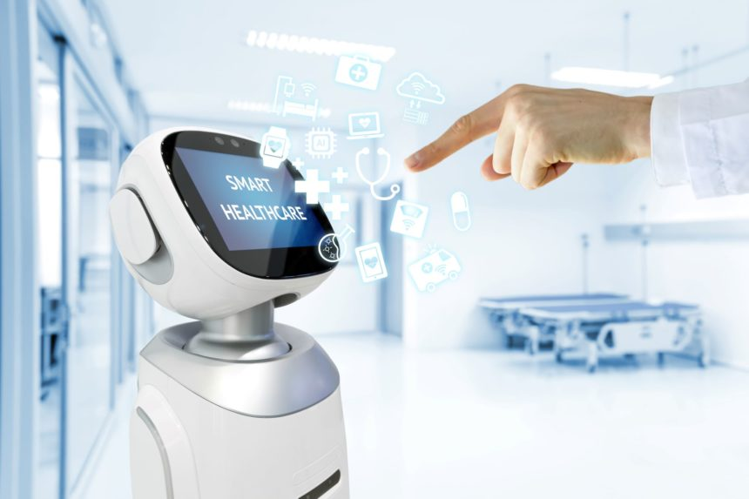
NOVELTY OF PROJECT
Round-the-Clock : The chatbot can provide assistance 24/7. Patients can get their queries answered in-time, and they can schedule their appointments whenever they want to.
Diagnosis Assistance: Patients can receive a quick diagnosis of their ailments based on their symptoms by answering a series of questions through the chatbot. This feature will help patients who are unable to physically visit the hospital.
Streamlined Administration : The chatbot can automate several administrative tasks, such as scheduling appointments, registration, payment processing. This can save hospital staff members' time, allowing them to focus on providing care to patients.

Slide 10
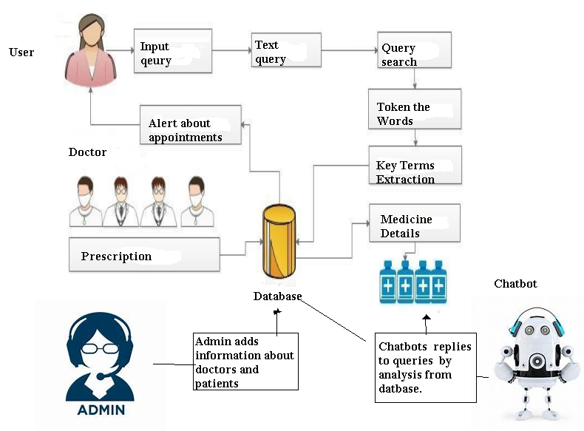
ARCHITECTURE:
Architecture of Hospital Management System using Chatbot

Slide 11



Modules
User:
Registration: user need to register to get credentials.
Login: usercan login using credentials.
Chat with Bot: user can chat with the bot regarding the query.
Admin:
Login:Admin can login by using credentials.
View Users:Admin can also view the users.
Manage Doctor Details:Admin can update details of available doctors.
Doctor:
Login:Doctors login using credentials.
Advise Prescription:Doctors advise prescription to corresponding patients.

Slide 12
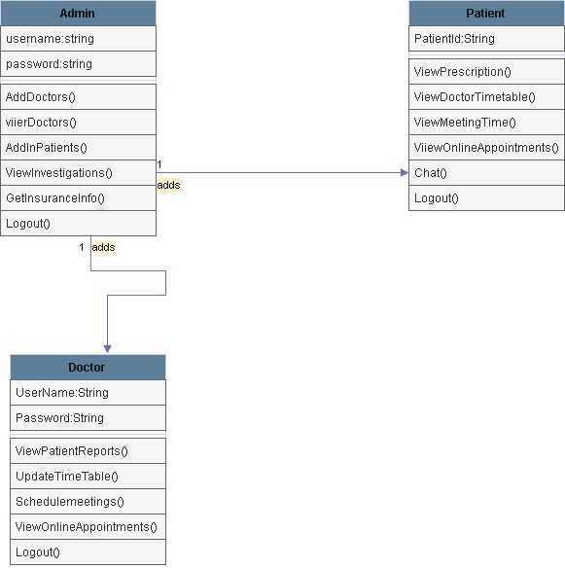
UML DIAGRAMS: Class Diagram:

Slide 13
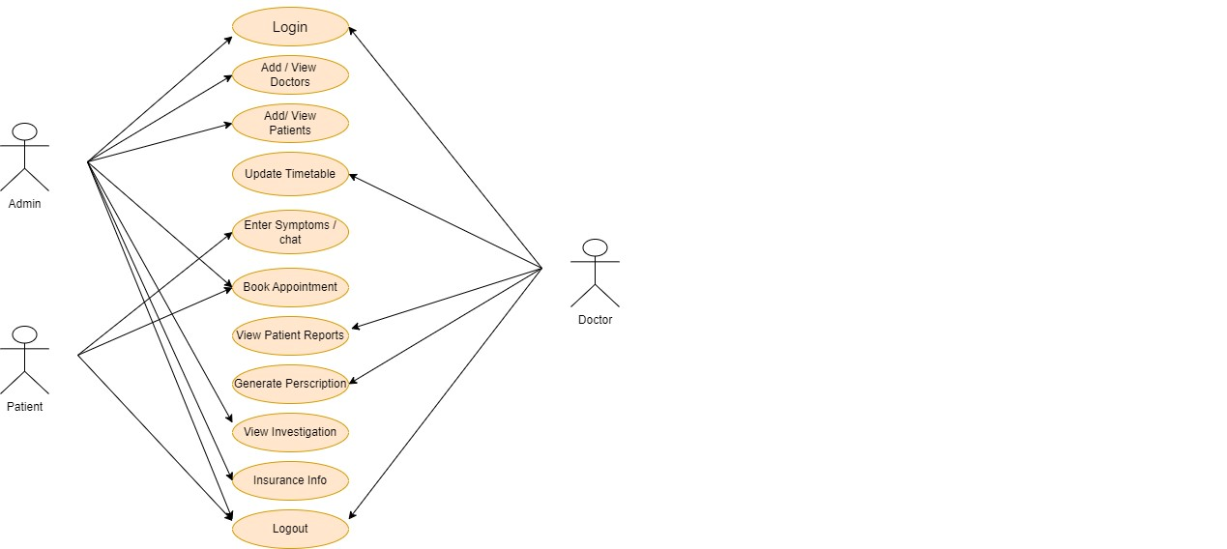
Usecase Diagram

Slide 14
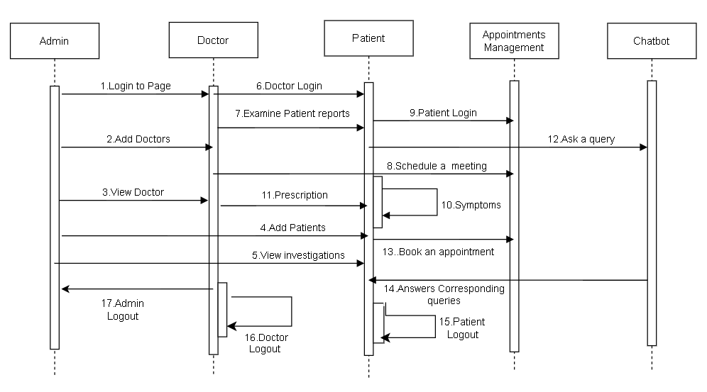
Sequence Diagram

Slide 15
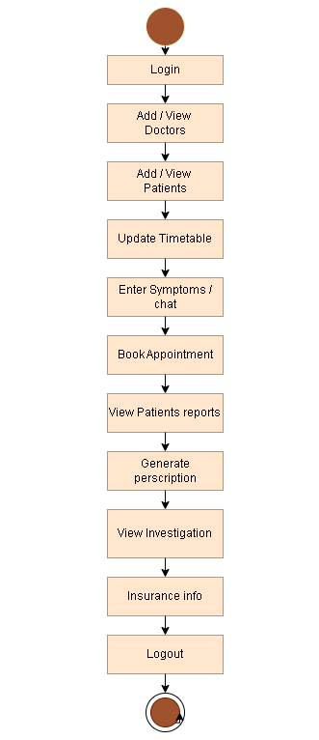
Activity Diagram

Slide 16
SAMPLE CODE
from django.shortcuts import render
from django.template import RequestContext
from django.contrib import messages
import pymysql
from django.http import HttpResponse
from django.core.files.storage import FileSystemStorage
import os
from datetime import date
import os
global userid, pnameValue, pdateValue

Slide 17
def Chat(request):
if request.method == 'GET':
return render(request, 'Chat.html', {})
def searchQuery(query, data):
arr = data.split(" ")
qry = query.split(" ")
count =0
for i in range(len(qry)):
for j in range(len(arr)):
if qry[i] == arr[j]:
count = count + 1
return count
def getTime(doctor):
available = "Not Available, Not Available, Not Available"
con = pymysql.connect(host='127.0.0.1',port = 3306,user = 'root', password = 'root', database = 'HospitalDB',charset='utf8')
with con:
cur = con.cursor()
cur.execute("select * FROM timetable1")
rows = cur.fetchall()
for row in rows:
if row[0] == doctor:
available = row[0]+","+row[1]+","+row[2]
break
return available

Slide 18
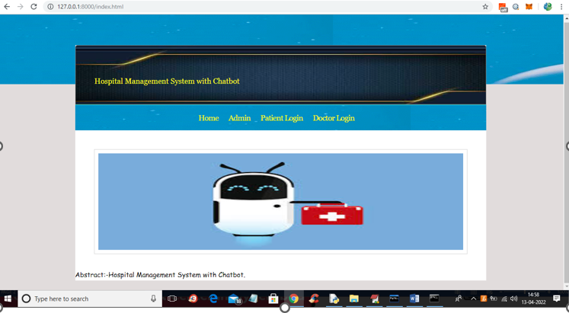
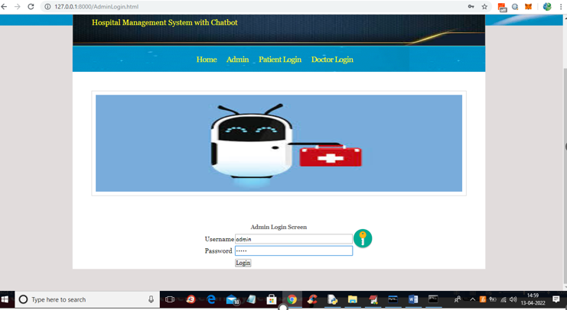
RESULTS
Fig: Home Page
Fig: Admin login Page

Slide 19
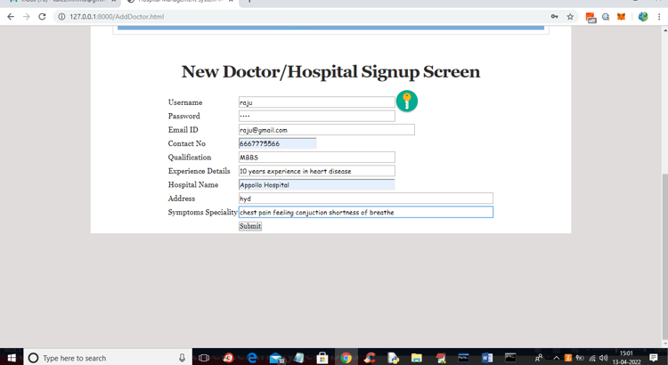
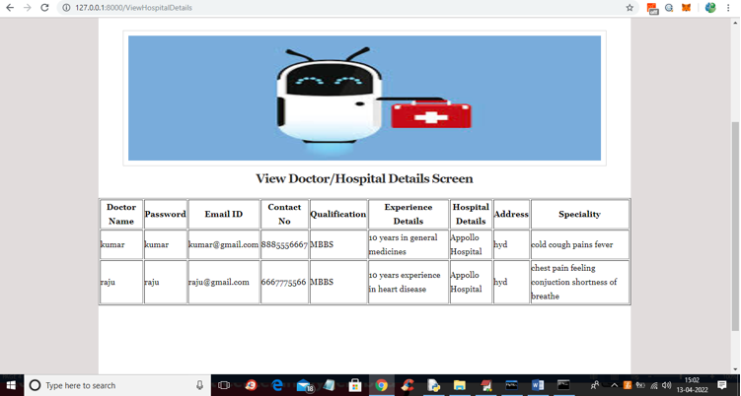
Fig: Doctor Sign Up Page
Fig: Doctor Details Page

Slide 20
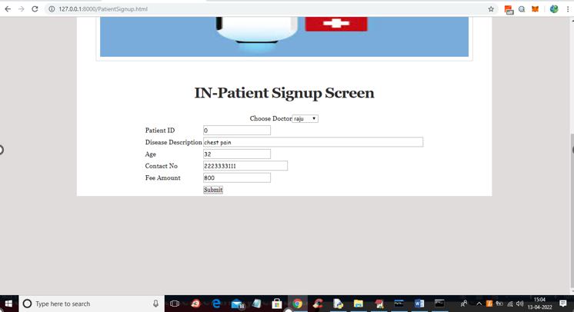
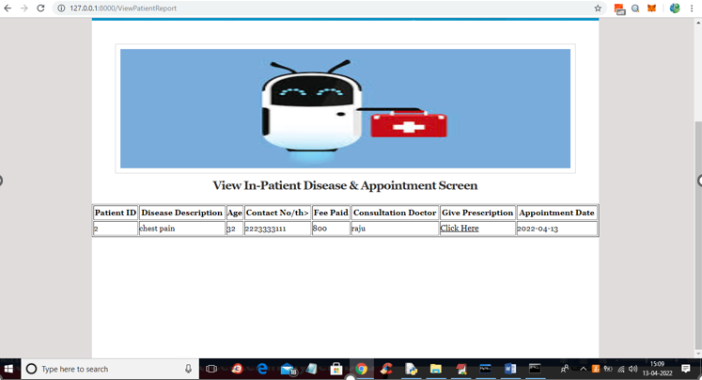

Slide 21
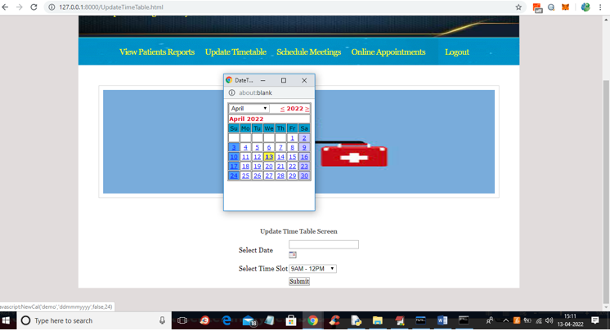
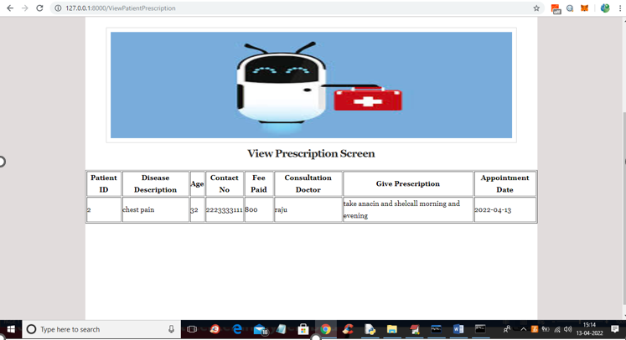
Fig: Doctor Updates Timetable
Fig: Prescription Page

Slide 22
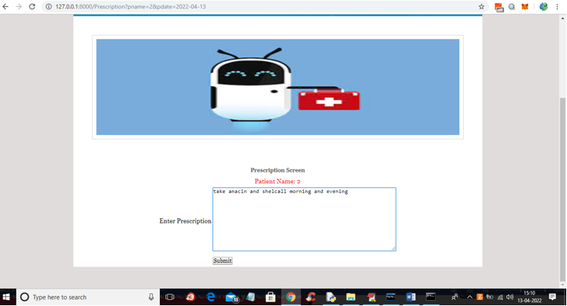
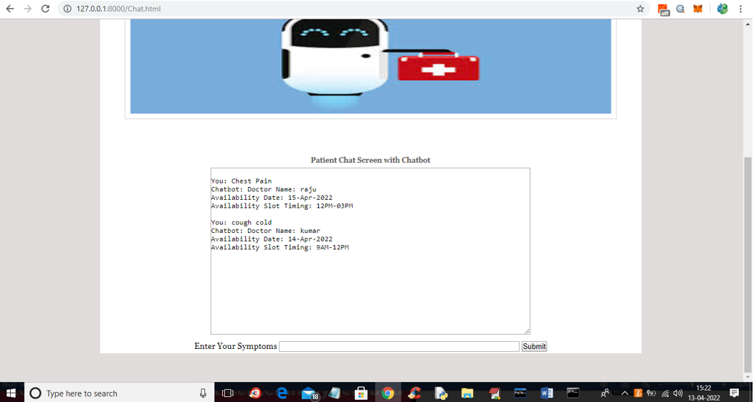
Fig: Patient Interaction with Chatbot
Fig: Chatbot replies to Patient

Slide 23

CONCLUSION
A Chatbot is a great tool for conversation. Here the application is developed to provide quality of answers in a short period of time. It removes the burden from the answer provider by directly delivering the answer to the user using an expert system. The project is developed for the user to save the user their time in consulting the doctors or experts for the healthcare solution. The application is improved with the security and effectiveness upgrades by ensuring user protection and characters and retrieving answers consequently for the questions.

Slide 24
FUTURE SCOPE
Telemedicine Integration:
Seamless integration with telemedicine platforms, allowing patients to initiate video consultations directly through the chatbot interface.
AI-aided Triage:
Using AI algorithms to assist in patient triage, helping determine the urgency of cases and suggesting appropriate actions.
Integration with Wearables and Health Apps:
Utilizing data from wearables and health applications to provide real-time health insights and recommendations.

Slide 25
REFERENCES
M. Mittal, B. Gopi, D. Singh, T. Nagarwal and P. Yadav, "Web-based chatbot for frequently asked queries (FAQ) in hospitals", Journal of Taibah University Medical Sciences, vol. 16, no. 5, pp. 740-746, 2021
R. B. Mathew, S. Varghese, S. E. Joy and S. S. Alex, "Chatbot for disease prediction and treatment recommendation using machine learning", 3rd Int. Conference on Trends in Electronics and Informatics, pp. 851-856, 2019

Slide 26
GITHUB LINK
https://github.com/BhavanaVanga/hospital-management-system-using-chatbot

Slide 27


